Slide 1
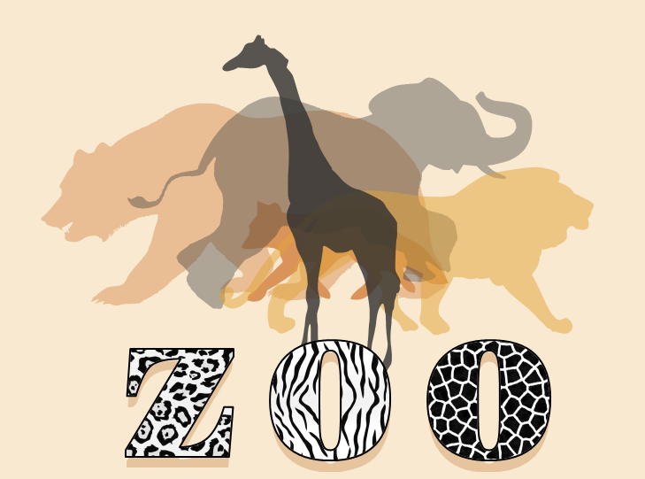
Animal Health and Habitat
project
Teeshyna Jhummun

Slide 2
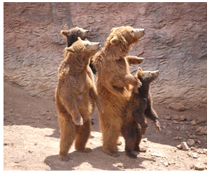
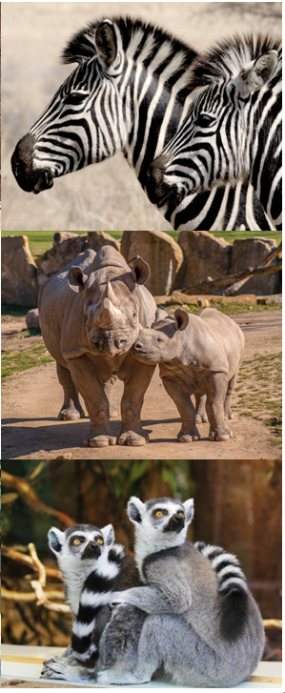
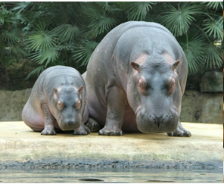
INTRODUCTION
Animal analysis using MySQL
Purpose : Design and implement a database to manage zoo animals, understand their eating habits and health within the zoo environments.
Extract animal dataset from Kaggle : https://www.kaggle.com/datasets/iamsouravbanerjee/animal-information-dataset

Slide 3
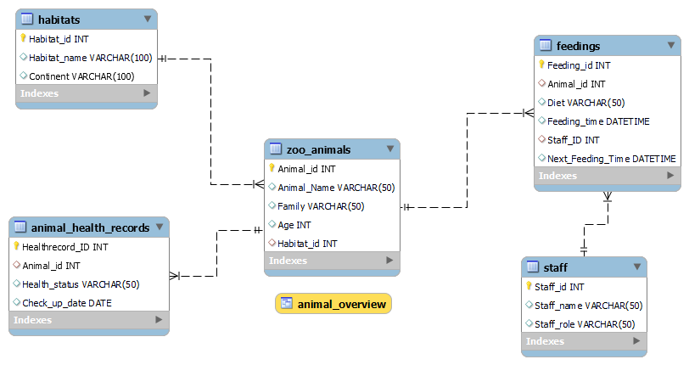
DATA MODEL
Using Kaggle Dataset: | Zoo animal Table
Animal | Name of animal
Diet | Type of diet the animal follows (Herbivore, Carnivore)
Habitat | Environment the animal is typically found in.
Continent | Continent that the animal is commonly found.
(PK)
(PK)
(FK)
(FK)
Table 2 | Primary Key | Foreign Key
Zoo_animals | Animal_Id | Habitat_id (references habitats)
Habitats | Habitat_id | None
Staff | Staff_id | None
Feeding | Feeding_id | Animal_id (references zoo_animals), Staff_ID (references staff)
Animal Health record | Healthrecord_ID | Animal_id (references zoo_animals)
(PK)
(PK)
(FK)
(FK)
(PK)

Slide 4
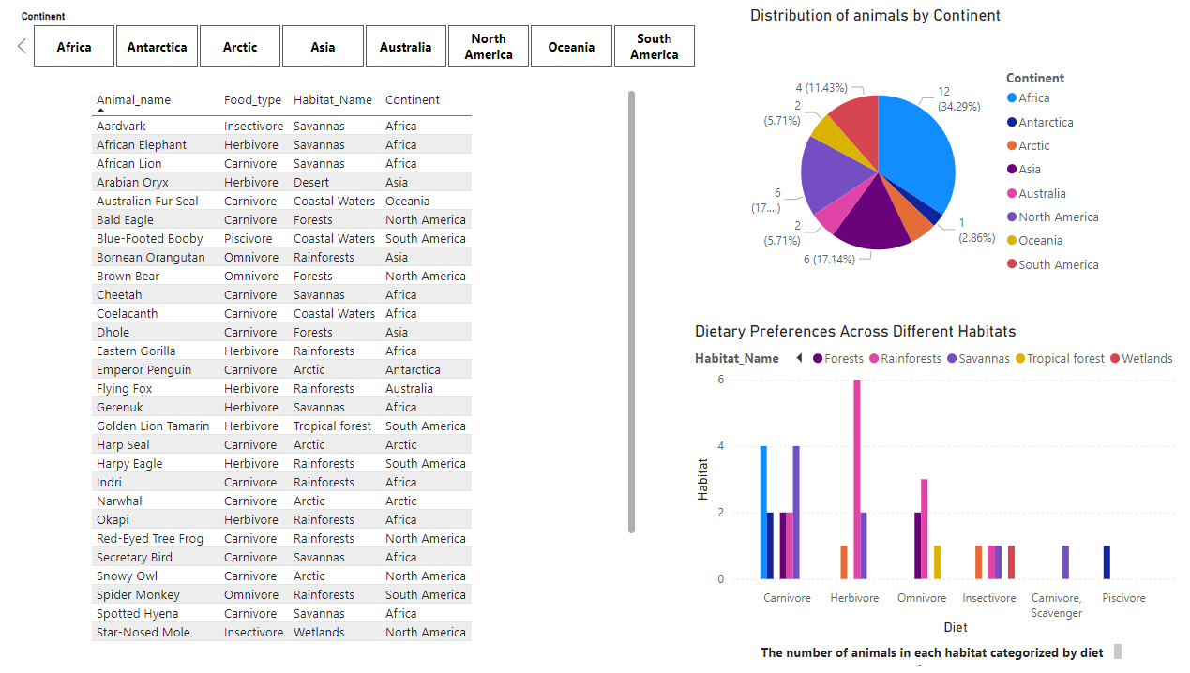
Using Power BI

